Slide 1


Cyclistic bike-share dashboard
Presented by: Sergey Khegay
Last Updated: JULY 7th, 2021

Slide 2
Table of Content
Bike Share Usage
Purpose Statement (What are we talking about?)
Tell Your Story (with Data)
Conclusion

Slide 3


What are we Talking about?
Objective
Identify if there are geographic, demographic, and/or time series factors that contribute to annual members and casual riders using Cyclistic bikes differently.

Slide 4
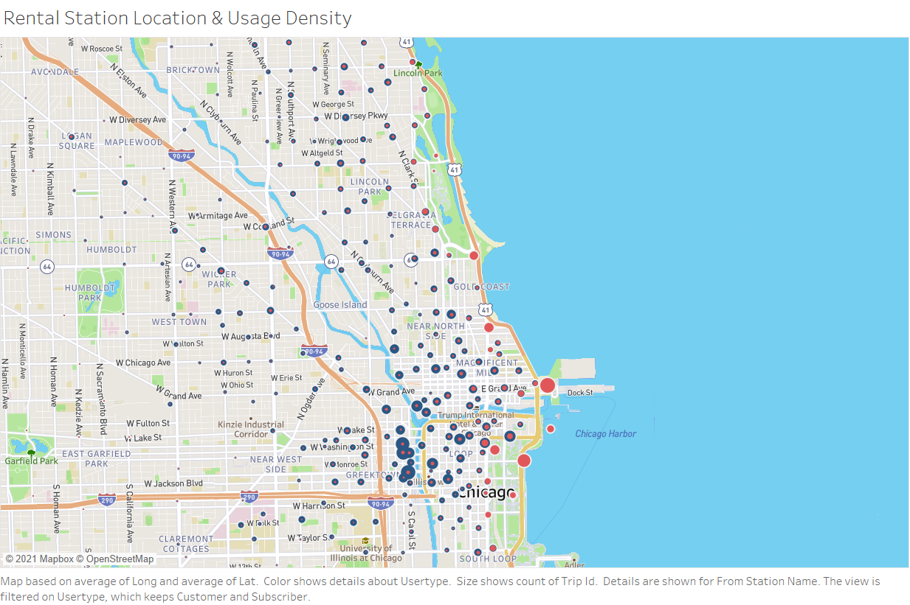
Geographic
Greektown and Loop districts contains rental station with high usage among annual members.
High correlation between rental station located close to urban parks and casual riders.
Geographic location of rental station in social and dining districts retain high bike usage.

Slide 5
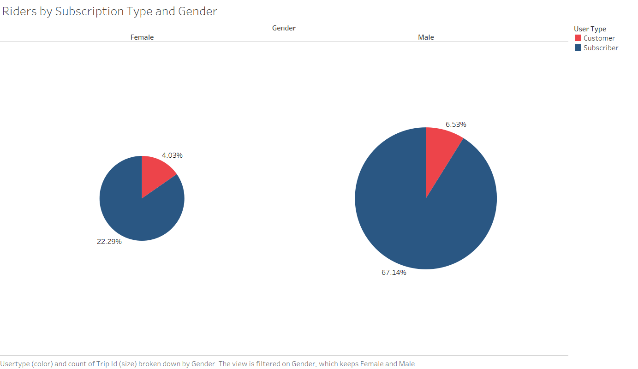
Demographic

Slide 6
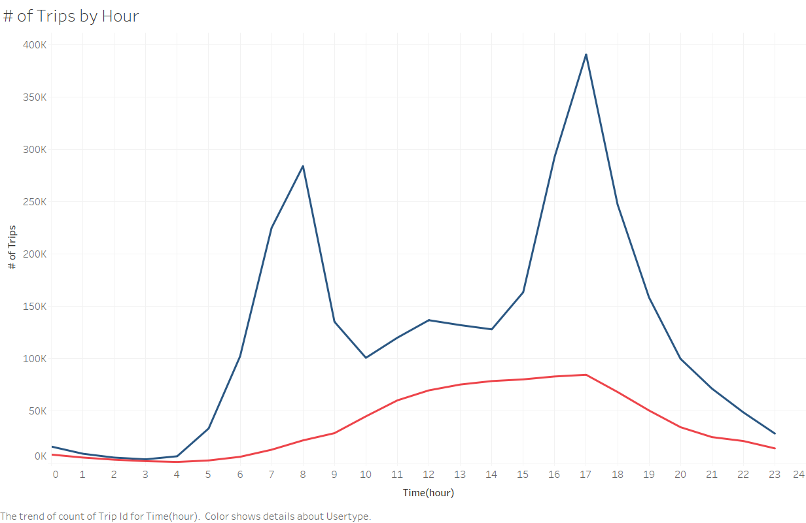
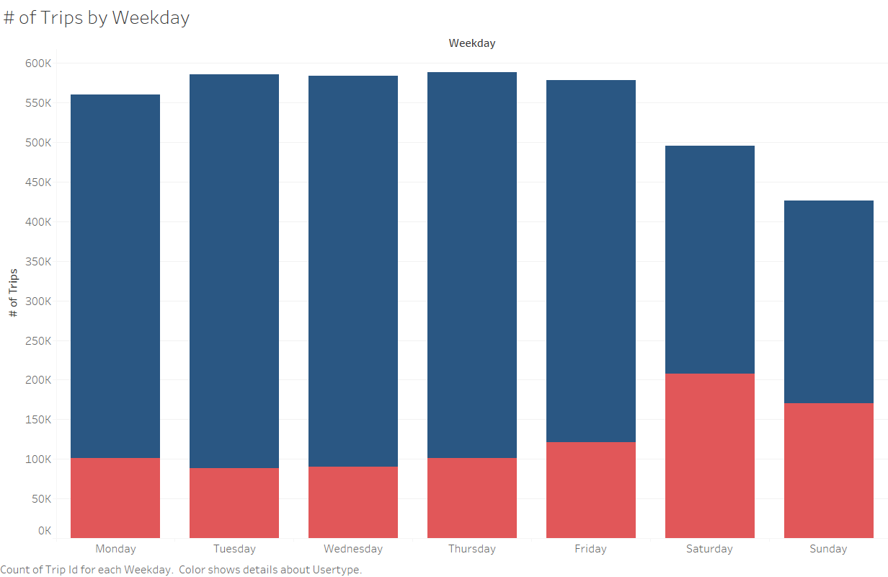
Time Series
Annual members generally use rental bikes for commute to between home and work.
Casual riders generally use rental bikes during weekends to commute or exercise between 10AM and 5PM.

Slide 7
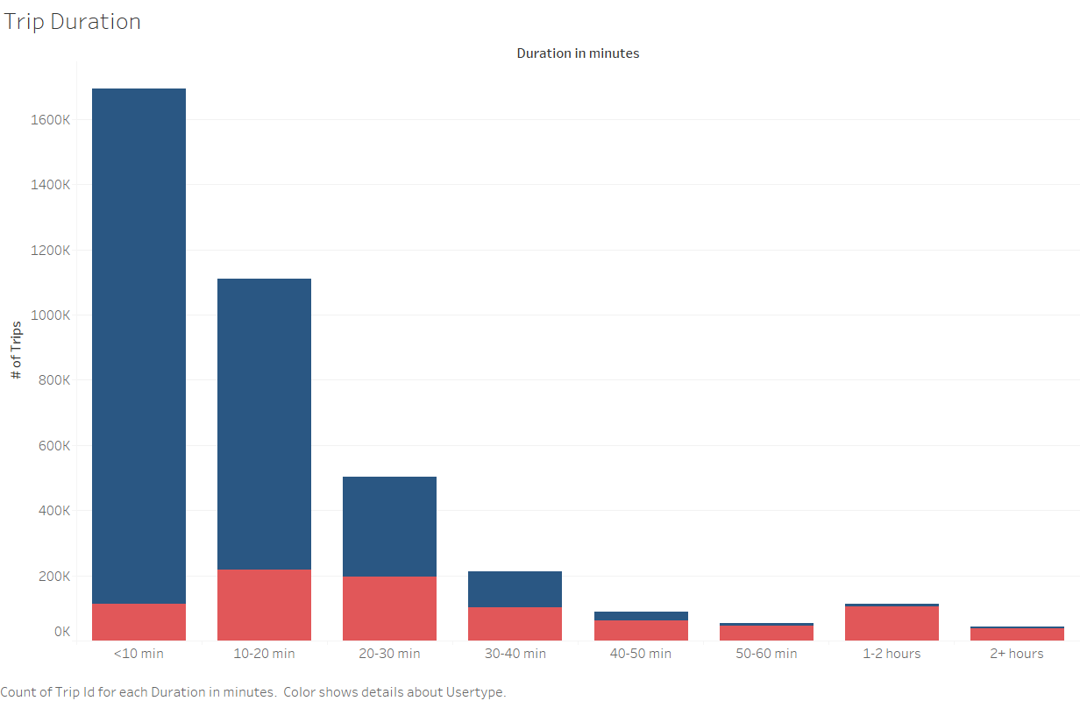
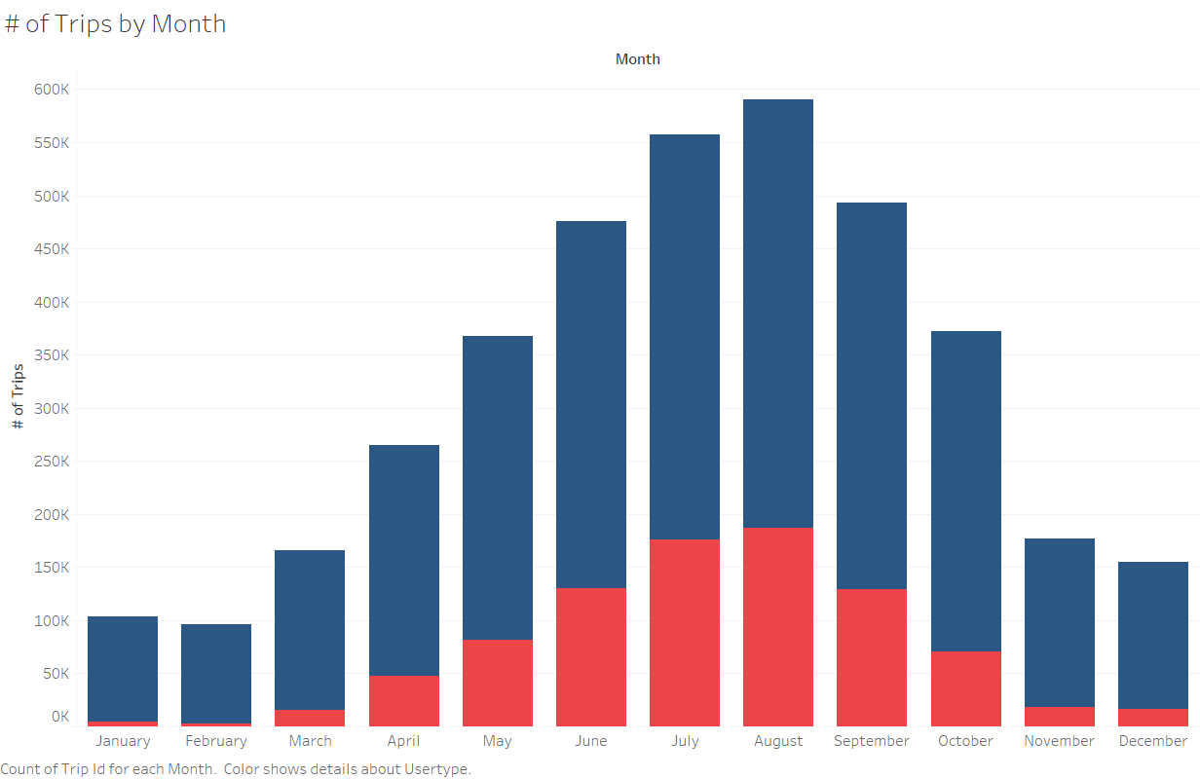
Time Series (cont.)
Most of the annual members generally rent bikes for 10 minutes or less.
Majority of casual riders rented a bike for more than 40 minutes.
There is an exponential increase in bike usage between March and August.

Slide 8
Conclusion
Majority of annual members use rental bikes to commute between work and home.
Social, dining and urban parks are the most popular spots with high bike rentals.
Annual transition to higher usage of bikes starts from spring and last until the end of Summer.
Weekends are the most popular days for bike rentals among casual riders with possible duration of over 40 minutes.

